Slide 1
Avon Tuff Glass Pvt. Ltd.
1. We are one of the leading and Saint Gobain Exclusive partner for all range of products.
2. We are “ 2 star (**)” glass processor of SGGI.

Slide 2
Quality Inspections & Reports with instruments
We are following European Quality Standards & Saint Gobain‘s special Quality Standards.
We follow Saint Gobain Quality Audit in every month.
“Quality” & “ Customer Delight “ are the key points for our success.

Slide 3
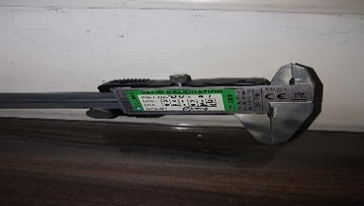
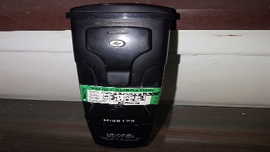
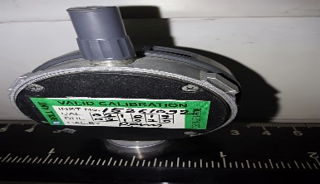
List of Instruments
Name of Instrument | Qty | Instrument No. | Date of Calibration | Due Date of Calibration | Image | Calibrated By
DIGITAL CALIPER | 1 | DV-01 | 2-Oct-19 | 2-Oct-20 |  | BRILLIANT CALIBRATION GST No: - 27AAJFB8295P1ZI
PH METER | 1 | 2200238991 | 2-Oct-19 | 2-Oct-20 |  | BRILLIANT CALIBRATION GST No: - 27AAJFB8295P1ZI
ROLLER WAVE GAUGE | 1 | 15261092 | 2-Oct-19 | 2-Oct-20 |  | BRILLIANT CALIBRATION GST No: - 27AAJFB8295P1ZI

Slide 4
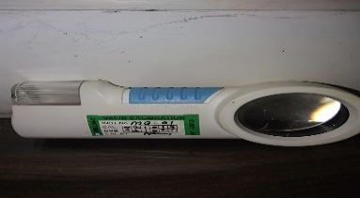
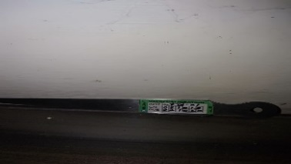
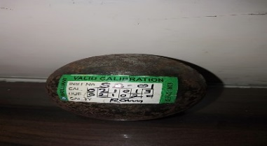
List of Instruments
Name of Instrument | Qty | Instrument No. | Date of Calibration | Due Date of Calibration | Image | Calibrated By
MAGNIFIER | 1 | MG-01 | 2-Oct-19 | 2-Oct-20 |  | BRILLIANT CALIBRATION GST No: - 27AAJFB8295P1ZI
TAPER GAUGE | 1 | TG-01 | 2-Oct-19 | 2-Oct-20 |  | BRILLIANT CALIBRATION GST No: - 27AAJFB8295P1ZI
BALL DROP TESTING MACHINE | 1 | SB-01 | 2-Oct-19 | 2-Oct-20 |  | BRILLIANT CALIBRATION GST No: - 27AAJFB8295P1ZI

Slide 5
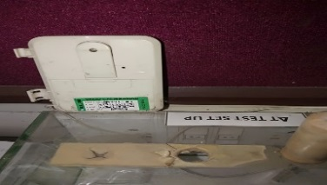
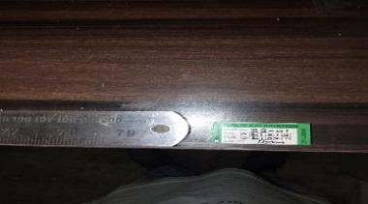
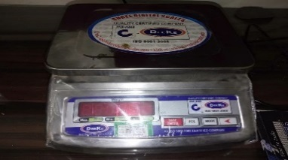
List of Instruments
Name of Instrument | Qty | Instrument No. | Date of Calibration | Due Date of Calibration | Image | Calibrated By
DELTA T TEST THERMOMETER | 1 | DTH-01 | 2-Oct-19 | 2-Oct-20 |  | BRILLIANT CALIBRATION GST No: - 27AAJFB8295P1ZI
SCALE (2 MTRS) | 1 | SS-01 | 2-Oct-19 | 2-Oct-20 |  | BRILLIANT CALIBRATION GST No: - 27AAJFB8295P1ZI
WEIGHT MACHINE (20 KG) | 1 | DWG-01 | 2-Oct-19 | 2-Oct-20 |  | BRILLIANT CALIBRATION GST No: - 27AAJFB8295P1ZI

Slide 6
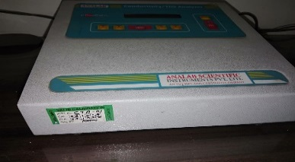
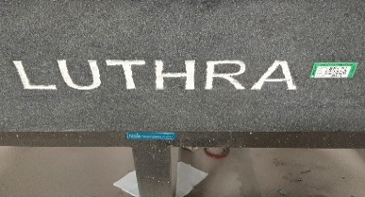
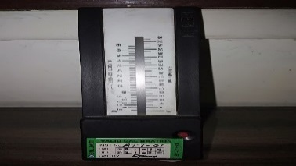
List of Instruments
Name of Instrument | Qty | Instrument No. | Date of Calibration | Due Date of Calibration | Image | Calibrated By
CONDUCTIVITY/TDS ANALYSER | 1 | CTA-01 | 2-Oct-19 | 2-Oct-20 |  | BRILLIANT CALIBRATION GST No: - 27AAJFB8295P1ZI
LUTHRA-SURFACE TABLE (2000 MMX1000 MM) | 1 | SP-01 | 2-Oct-19 | 2-Oct-20 |  | BRILLIANT CALIBRATION GST No: - 27AAJFB8295P1ZI
MERLIN (AIR GAP) TESTER | 1 | ATT-01 | 2-Oct-19 | 2-Oct-20 |  | BRILLIANT CALIBRATION GST No: - 27AAJFB8295P1ZI

Slide 7
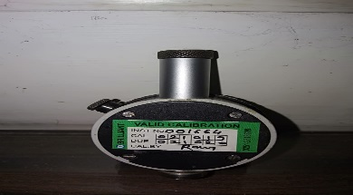
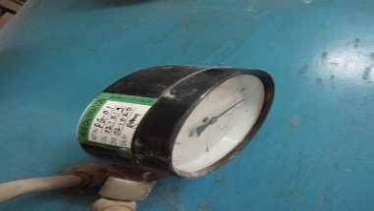
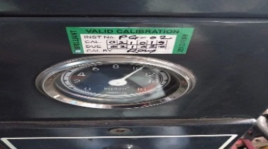
List of Instruments
Name of Instrument | Qty | Instrument No. | Date of Calibration | Due Date of Calibration | Image | Calibrated By
SHORE-A HARDNESS TESTER | 1 | 1664 | 2-Oct-19 | 2-Oct-20 |  | BRILLIANT CALIBRATION GST No: - 27AAJFB8295P1ZI
PRESSURE GAUGE 1 (AIR COMPRESSOR) | 2 | PG-01 | 2-Oct-19 | 2-Oct-20 |  | BRILLIANT CALIBRATION GST No: - 27AAJFB8295P1ZI
PRESSURE GAUGE 2 (AIR COMPRESSOR) |  | PG-02 | 2-Oct-19 | 2-Oct-20 |  | BRILLIANT CALIBRATION GST No: - 27AAJFB8295P1ZI

Slide 8
Warehouse
1.Visual inspection for Incoming Material
2. Inspection for Raw Material Defects
3. Incoming Raw Glass Inspection Check Sheet

Slide 9
Incoming Raw Glass Inspection Report (WH)

Slide 10
CNC / Cutting
Glass Size Checking
Diagonal Checking
Visual Defects ( Bubble , Coating corrosion , coating damage , paper marks .etc. ) checking
Trim Breaking ( Edge Quality ) Checking

Slide 11
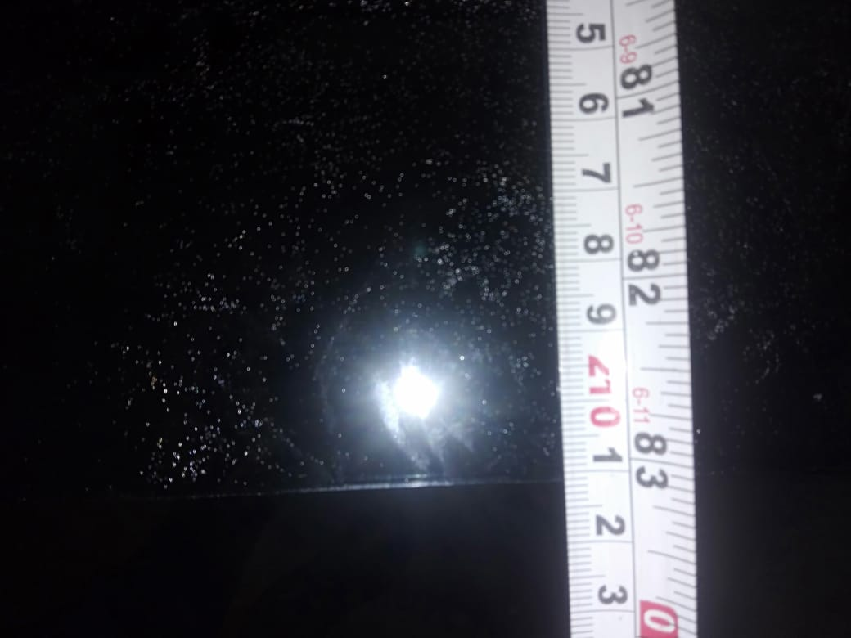
Glass Sizes & Diagonal

Slide 12
In process Inspection Report ( CNC/Cutting )

Slide 13
Grinding / Polishing ( Double Edger )
DM Water Quality (pH , Conductivity , TDS ) Checking
Sizes & Diagonal Checking
Visual Defects ( Bubble , Coating corrosion , coating damage , paper marks , water mark .etc. ) checking
Washing Quality Checking
Polishing Quality Checking

Slide 14
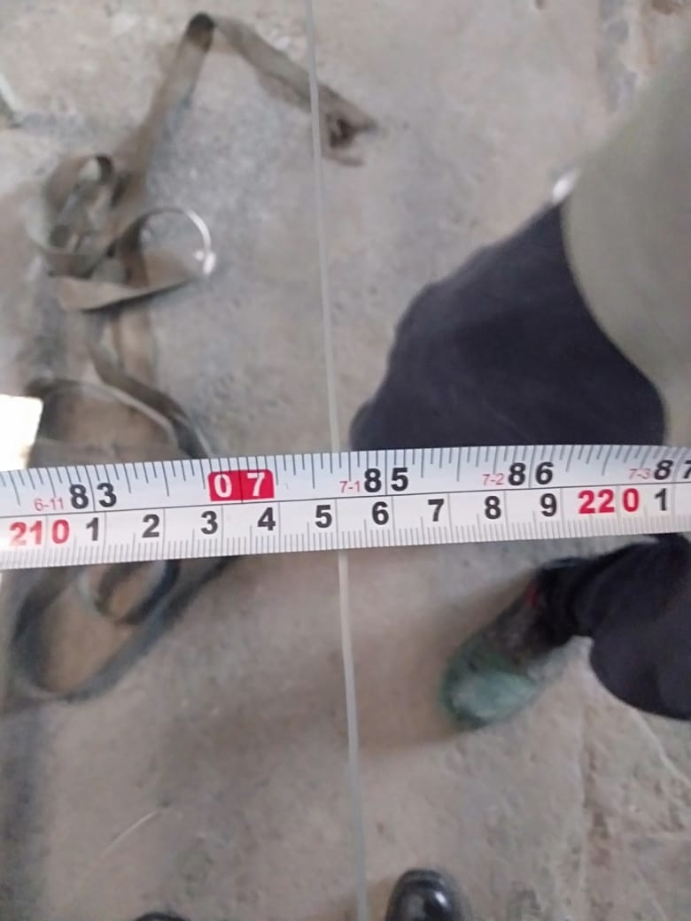
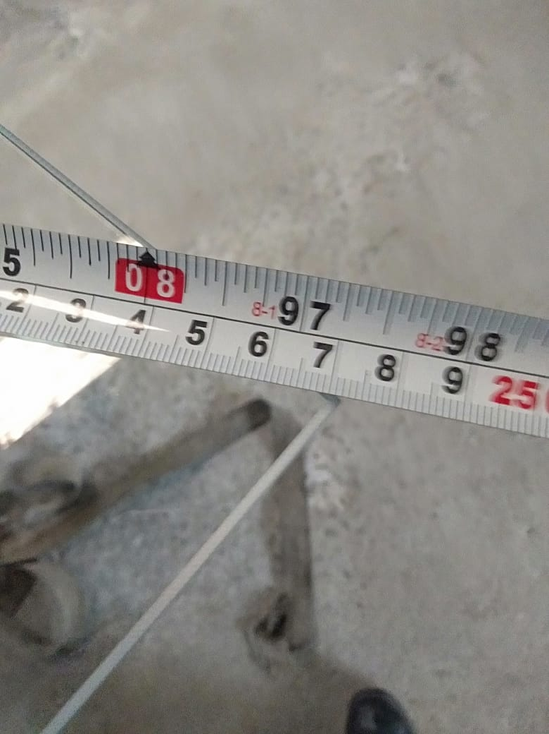
Glass Sizes & Diagonal

Slide 15
In process Inspection Report ( Grinding )

Slide 16
Fabrication ( Drilling )
Glass Size Checking
Diagonal Checking
Holes & Cut outs checking
Corner Round Quality Checking

Slide 17
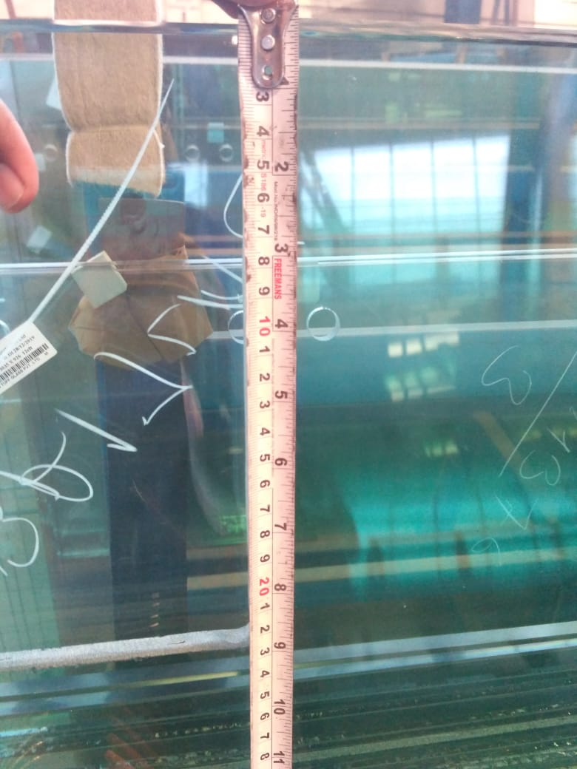
Holes & Cut outs
Hole @ 22 mm
Cutout @ 225 mm

Slide 18
In process Inspection Report ( Fab )

Slide 19
Washing
DM Water Quality ( pH , Conductivity , TDS ) Checking
Size & Diagonal Checking
Washing Quality Checking

Slide 20
In process Inspection Report ( Washing )

Slide 21
Screen Printing
Glass Sizes & Diagonal
Screen Design Checking
Paint Viscosity Checking
Paint colour Checking
Pin Holes Checking

Slide 22
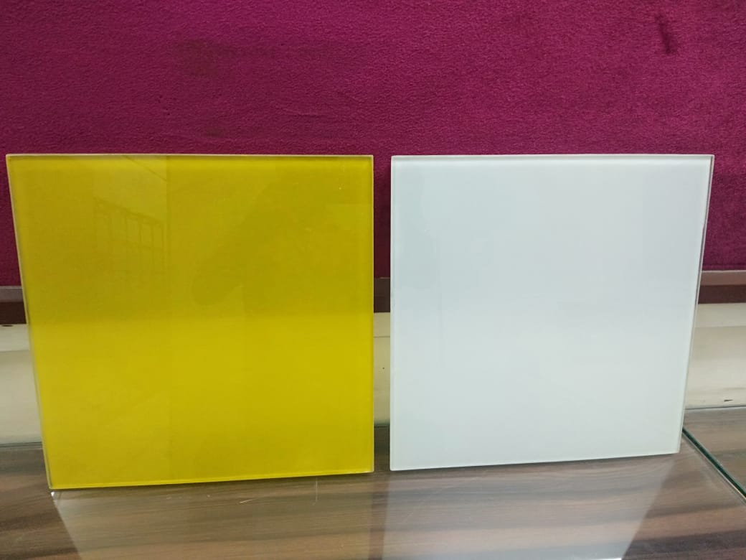
Viscosity Cup & Painted Glass
Painted Glasses
Viscosity Cup

Slide 23
Tempering
Glass Size Checking
Diagonal Checking
Grinding Quality Checking
Fragmentation Test
Zebra board Distortion Checking
Waviness Checking
Bend Checking
Surface Stress Measurement
Edge Dip Checking
Logo Checking

Slide 24
Fragmentation Test
Fragmentation Test

Slide 25
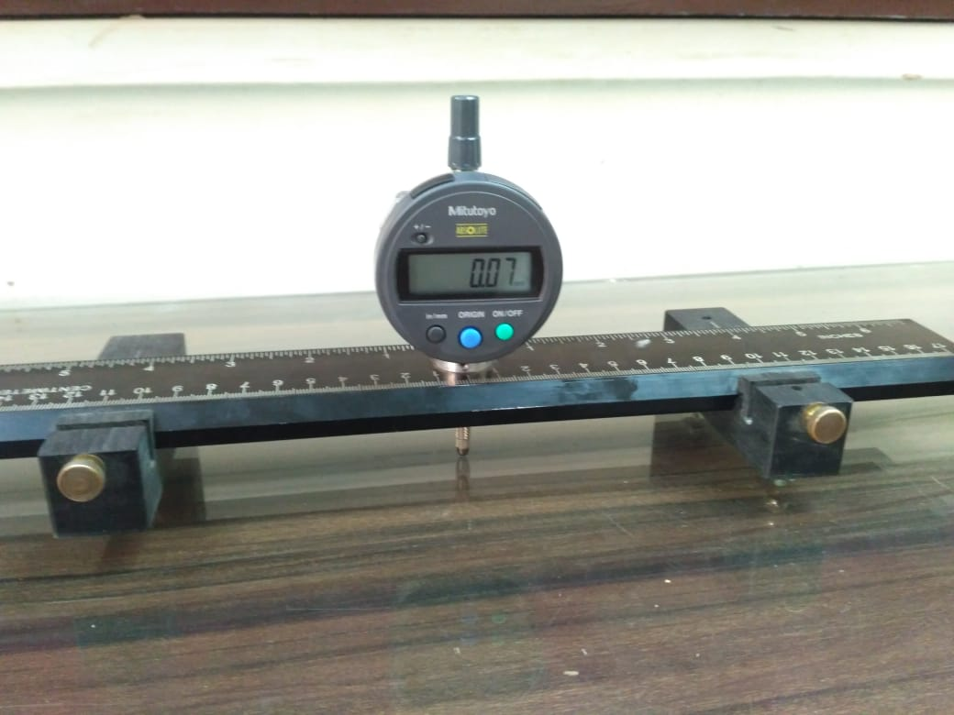
Zebra Board Distortion & Roller Wave
Distortion
Waviness

Slide 26
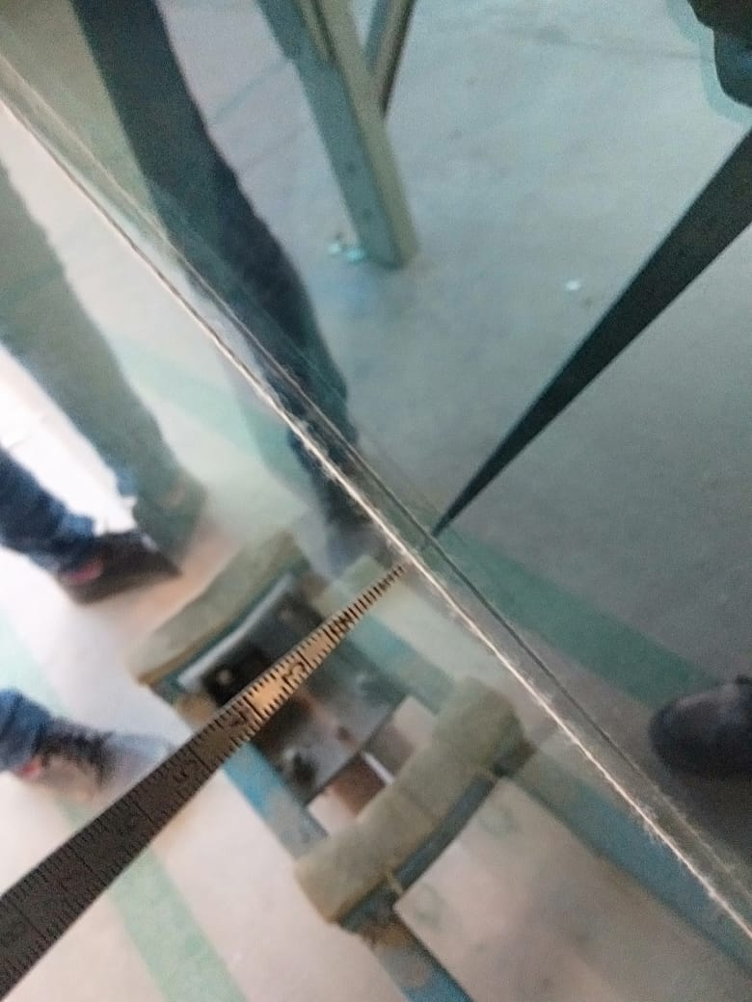
Edge Dip & Overall bow
Edge Dip
Bend

Slide 27
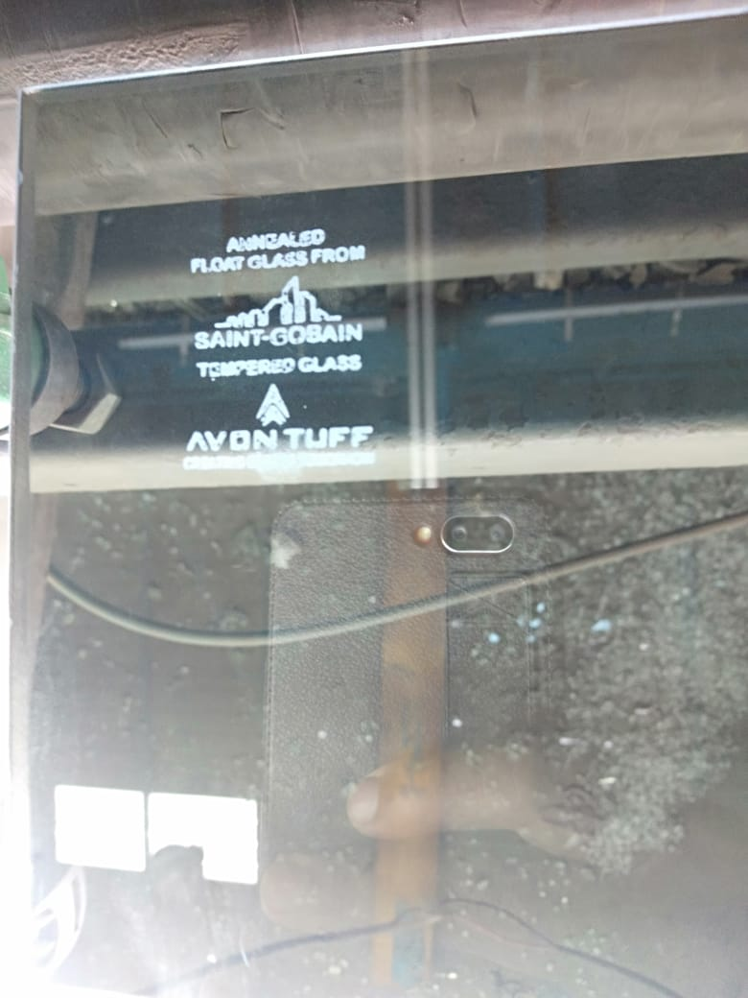
Surface Stress & Logo
Surface Stress
Logo

Slide 28
In process Inspection Report ( Temp )

Slide 29
IGU
Glass Size Checking
Diagonal Checking
Logo Checking
Butyl weight Checking
Desiccant Temperature Checking
Butterfly Test
Pot Life Test
Shore – A Hardness Test
9. Adhesion Test
10. Water Leakage Test
11. Air Gaps Checking
12. Mismatch checking
13. Silicone Depth checking
14. Butyl Depth checking
15. Sealant Ratio Test

Slide 30
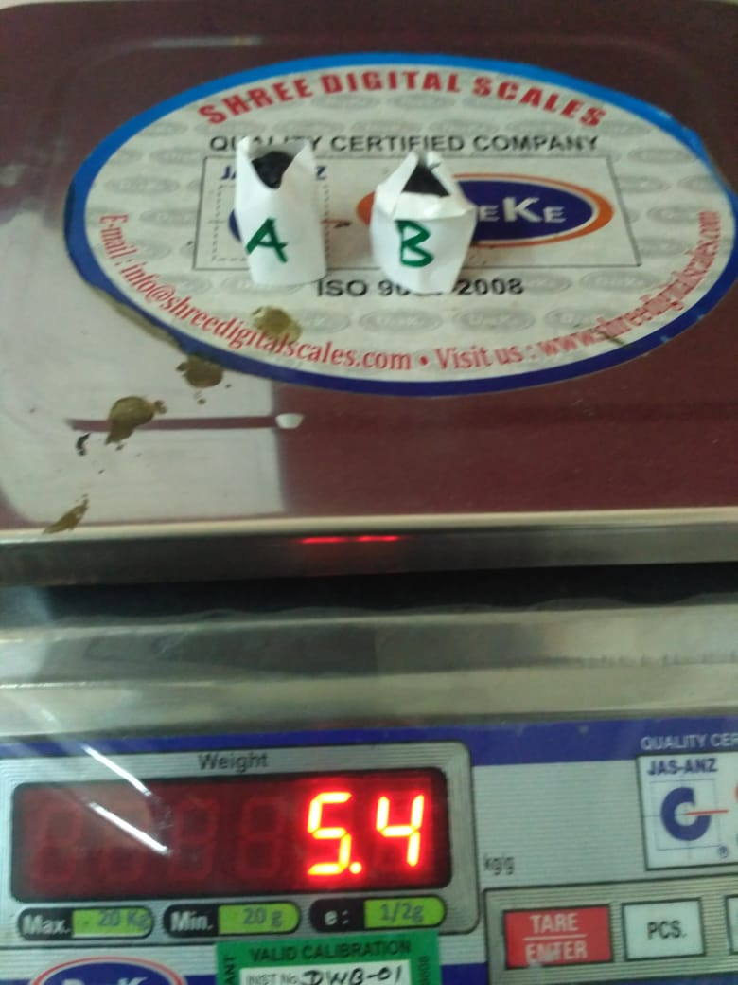
Butterfly & Butyl Weight
Butterfly Test
Butyl Weight

Slide 31
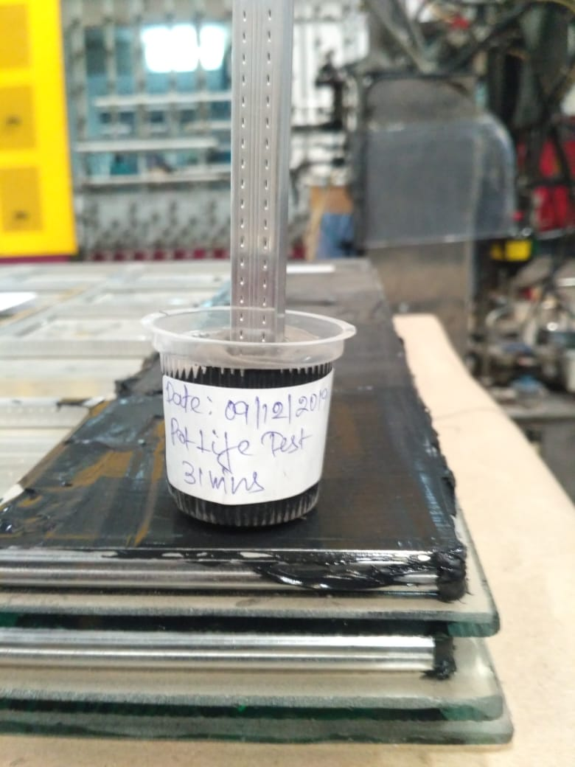
Shore-A Hardness & Pot-Life Test

Slide 32
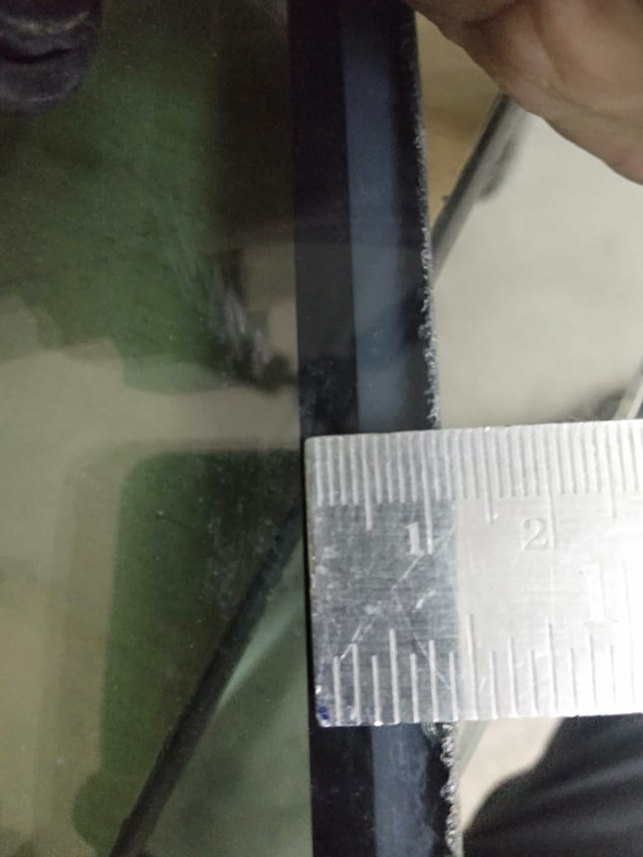
Silicone Depth & Butyl Depth
Silicon Depth @6 mm
Butyl Depth @ 4mm

Slide 33
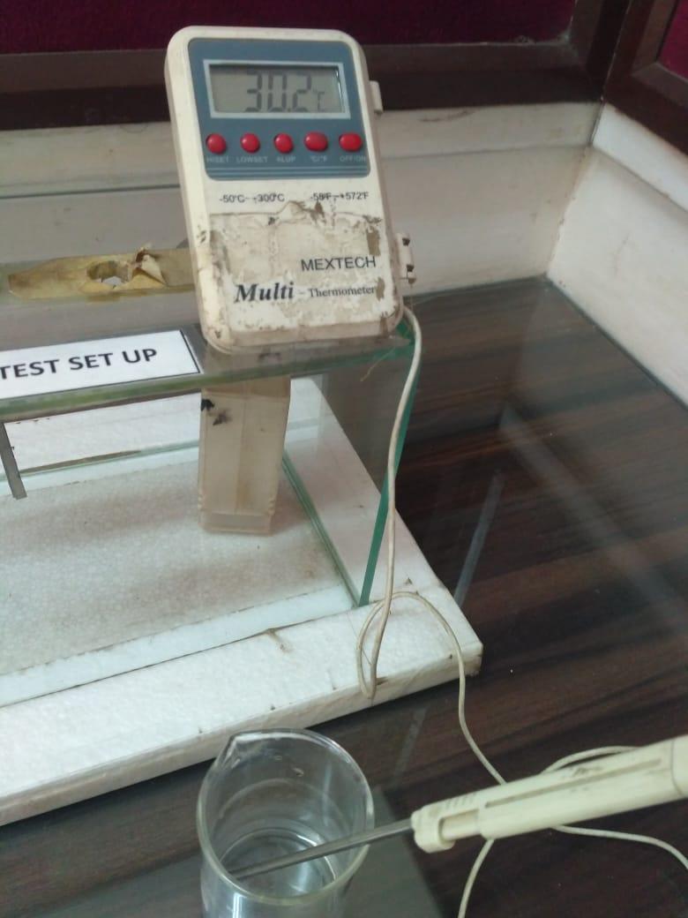
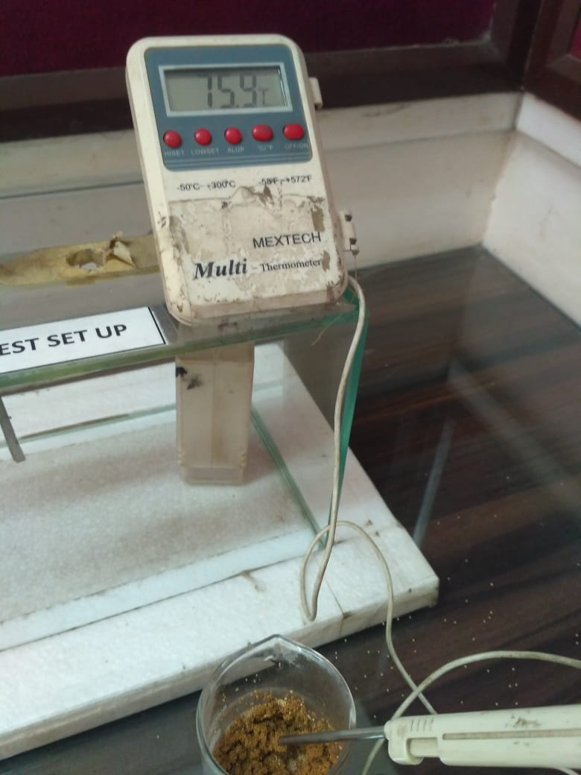
Desiccant Test & Air Gap Measurement
Air Gap
Water Temp.
Raising Temp.

Slide 34
In process Inspection Report(IGU )

Slide 35
Dispatch
Glass Size Checking
Protective Film Checking ( as per client requirement )
Vehicle Conditions
Packing Standards

Slide 36
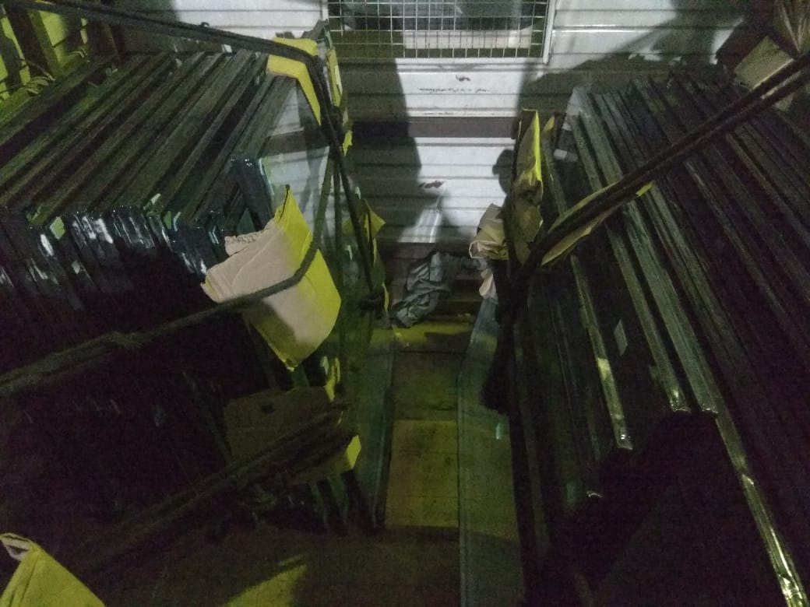
Packing & Loading
Packing & Loading
Packing & Loading

Slide 37
Prepared By .
Sanmay ( HOD – Quality )
&
Prince ( Executive – Quality )

Slide 38
Thank You
From
Sanmay ( HOD – Quality )

